Slide 1
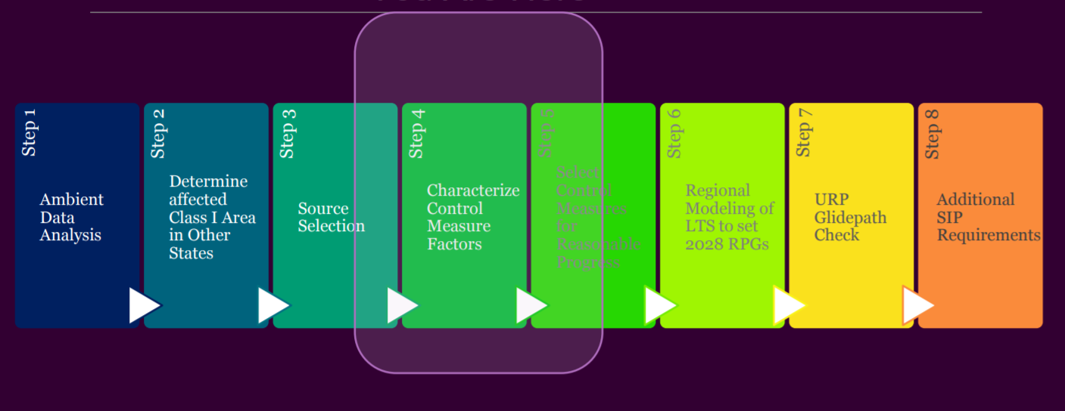
States
Steps follow RHR and EPA Guidance
Review, Coordination, Consultation
Coordination and Glidepath Subcommittee Call
March 12, 2020

Slide 2
WRAP 2014v2, RepBase, and 2028 OTB Emissions
Status
2014v2, Representative Base, and 2028 OTB emissions files delivered by Ramboll to CIRA
Representative Base is a mix of 2014 to 2018 emissions
2014v2 for on-road and industrial point
2018 measured emissions for EGU
2014 update for 6 WRAP states, EPA 2016eh for rest WRAP
EPA 2016eh for WRAP Nonroad, WRAP non-point, non-WRAP US
WRAP Fires are 2014-2018 5-year average
2028 On The Books uses 2014v2 or RepBase fire emissions
All other WRAP sectors are same in 2028 On the Books
EPA 2028eh for non-WRAP

Slide 3
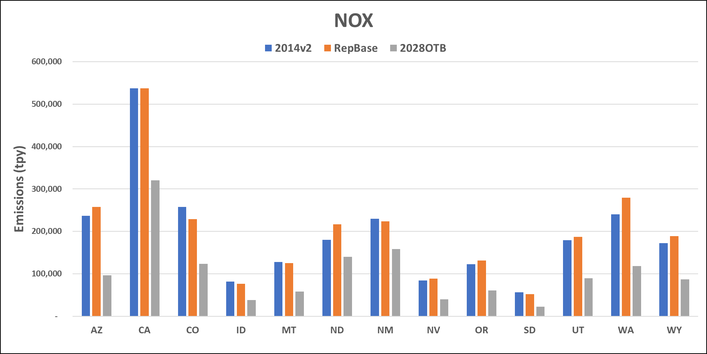
WRAP Anthropogenic Emissions (except no Fire)

Slide 4
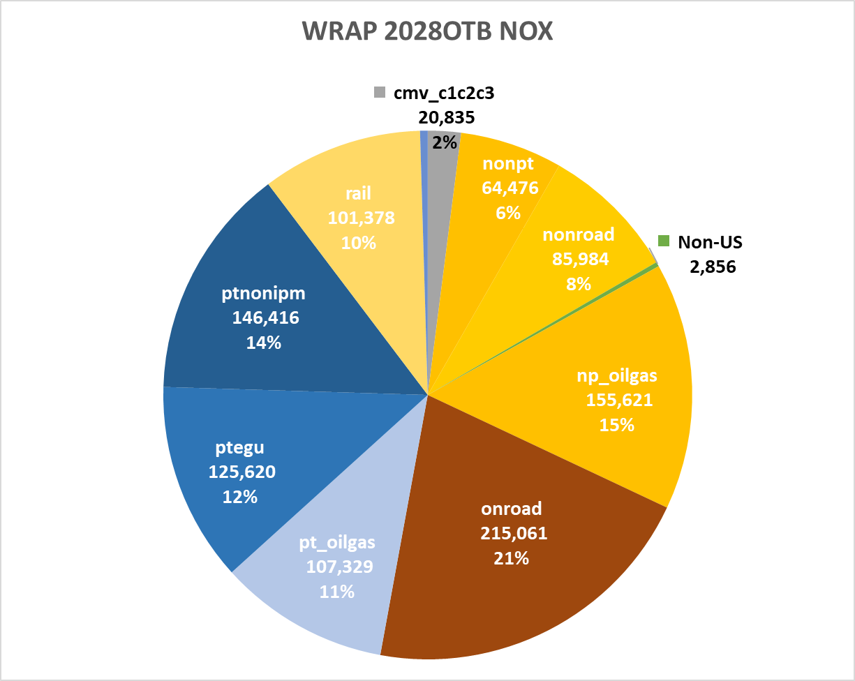
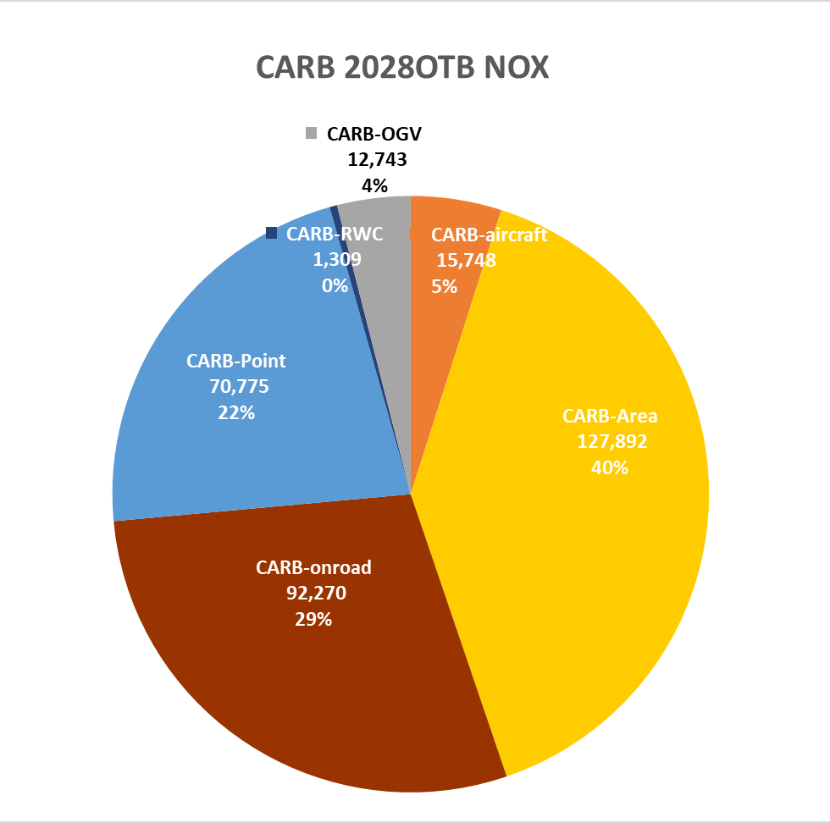
Remix CA so comparable to WRAP sectors - 2028

Slide 6
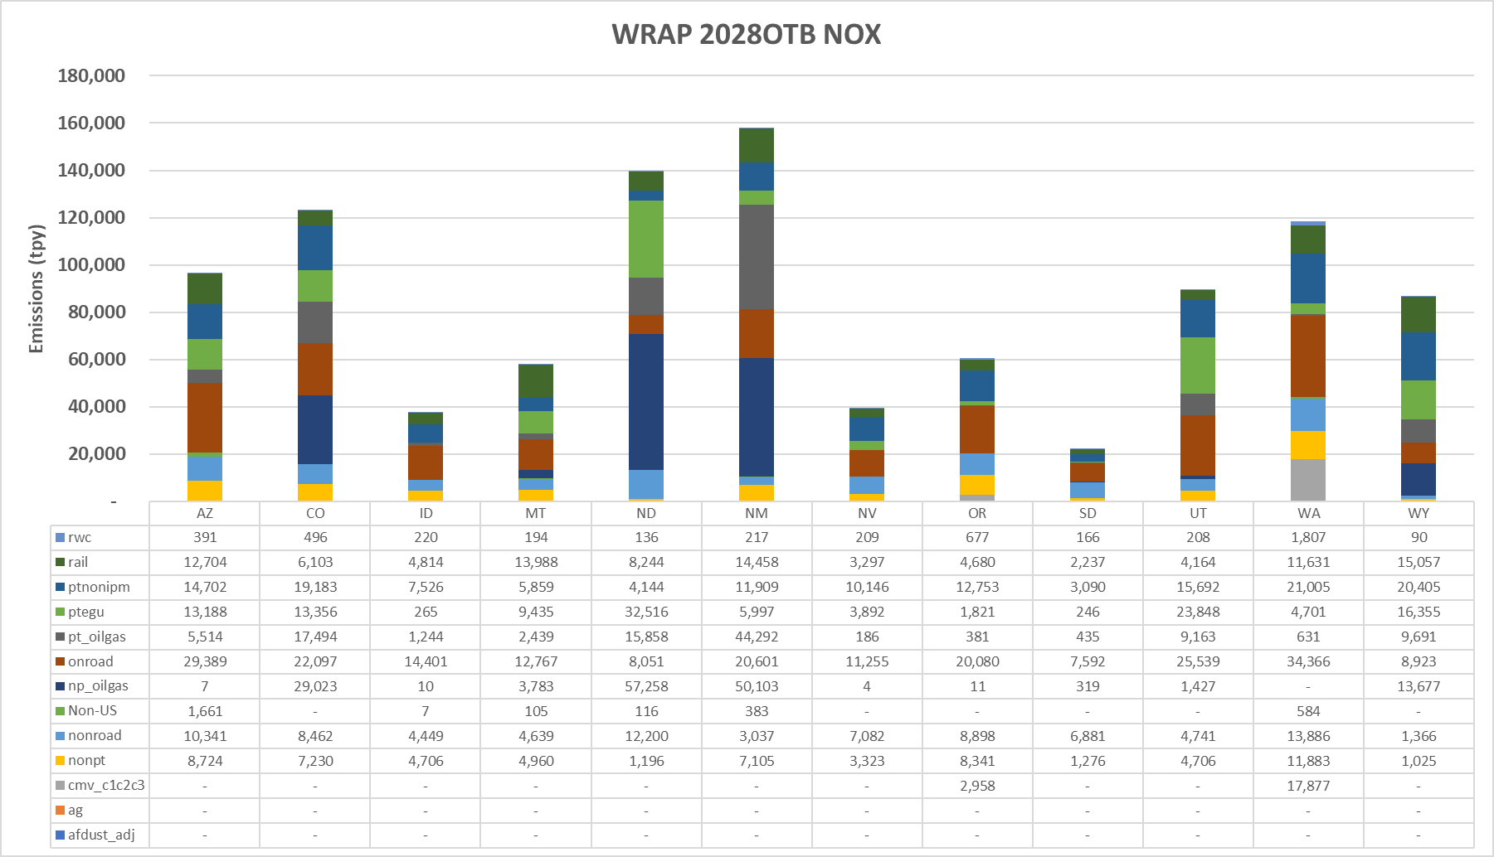
WRAP State Anthropogenic Source Sectors (no Fire)

Slide 7
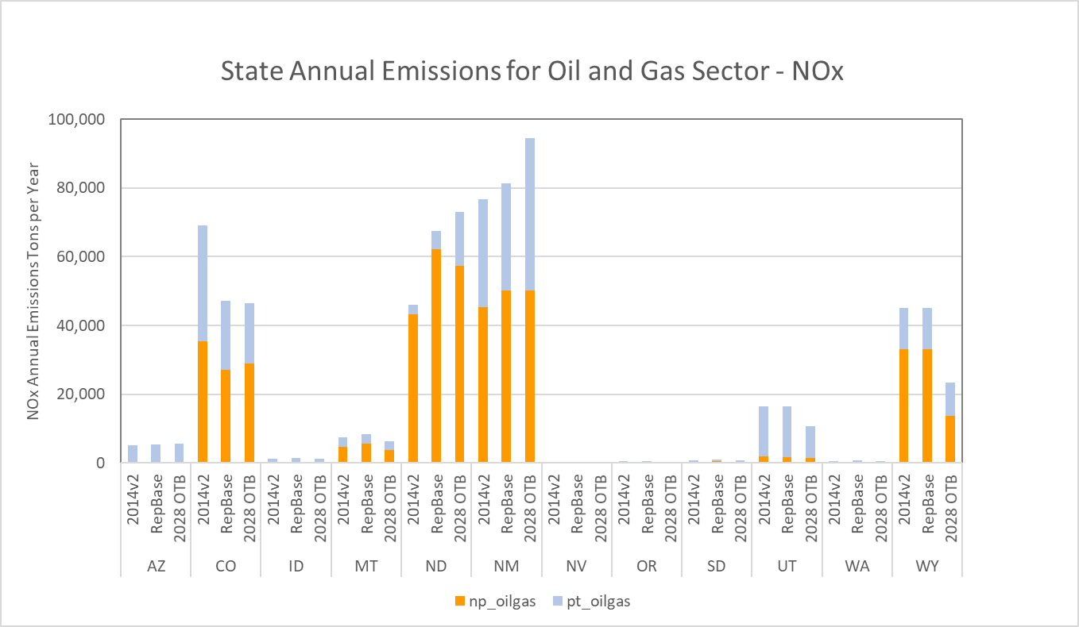
WRAP State 201v2, RepBaseline, and 2028 Emissions – Oil and Gas
http://www.wrapair2.org/pdf/WRAP_OGWG_Report_Baseline_17Sep2019.pdf
http://www.wrapair2.org/pdf/WRAP_OGWG_2028_OTB_FinalReport_11Oct2019a.pdf

Slide 8
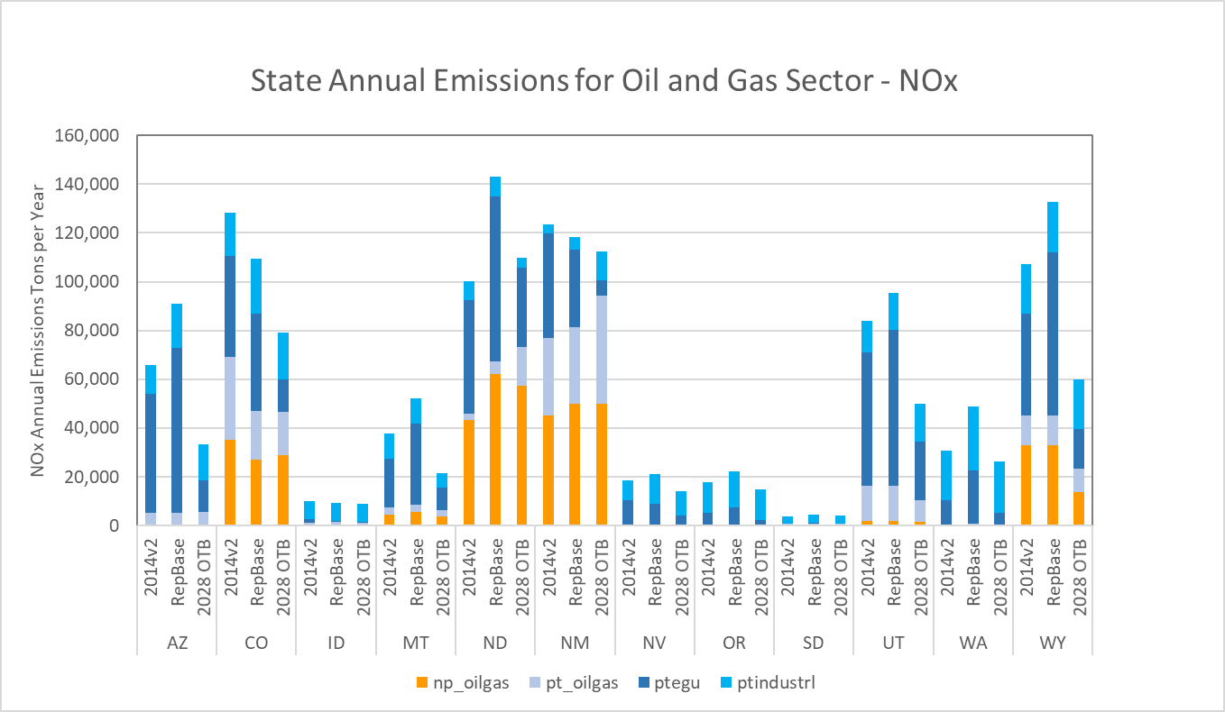
WRAP State Oil&Gas, EGU, Industrial Point

Slide 9
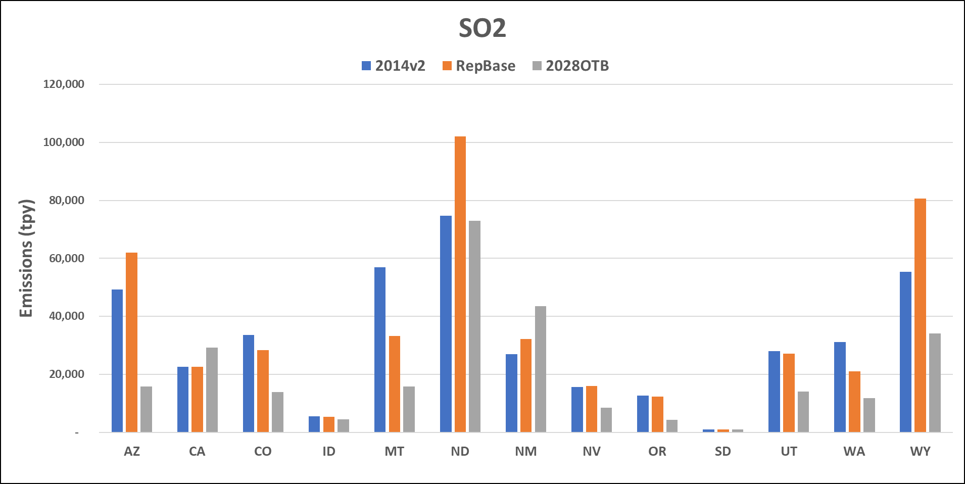
US Anthropogenic Emissions (no Fire)

Slide 10
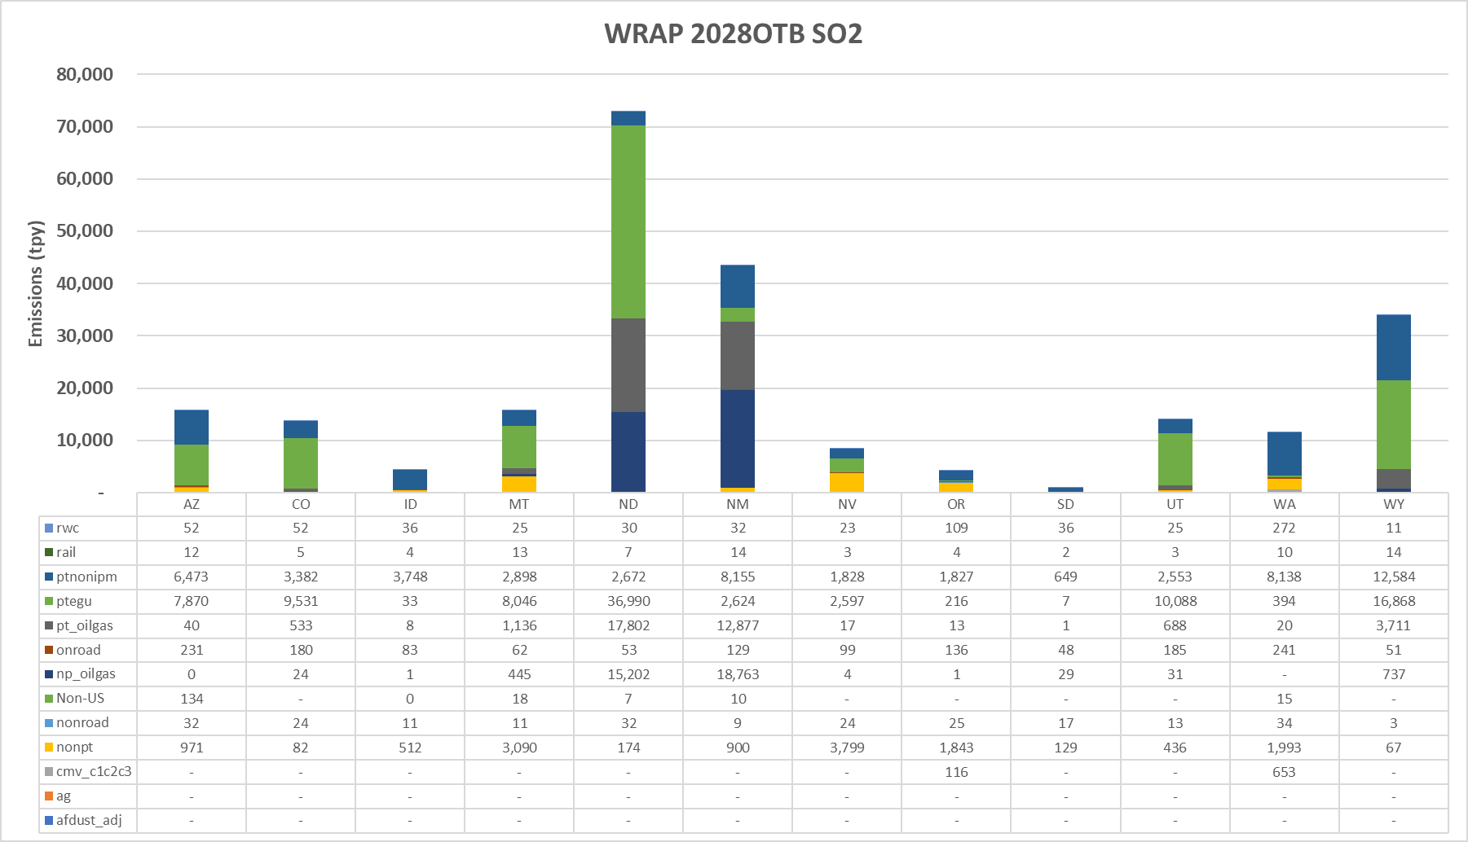
WRAP State Anthropogenic Source Sectors (no Fire)

Slide 11
Shawn to test-drive displays

Slide 12
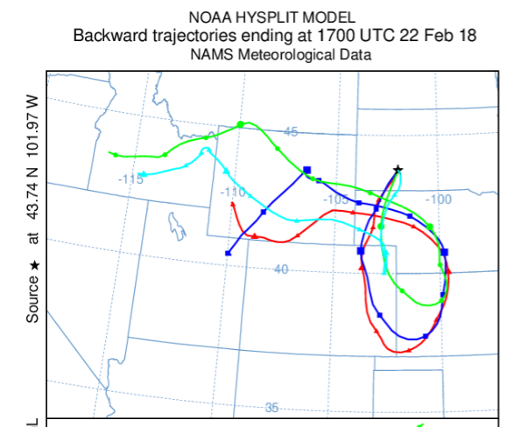
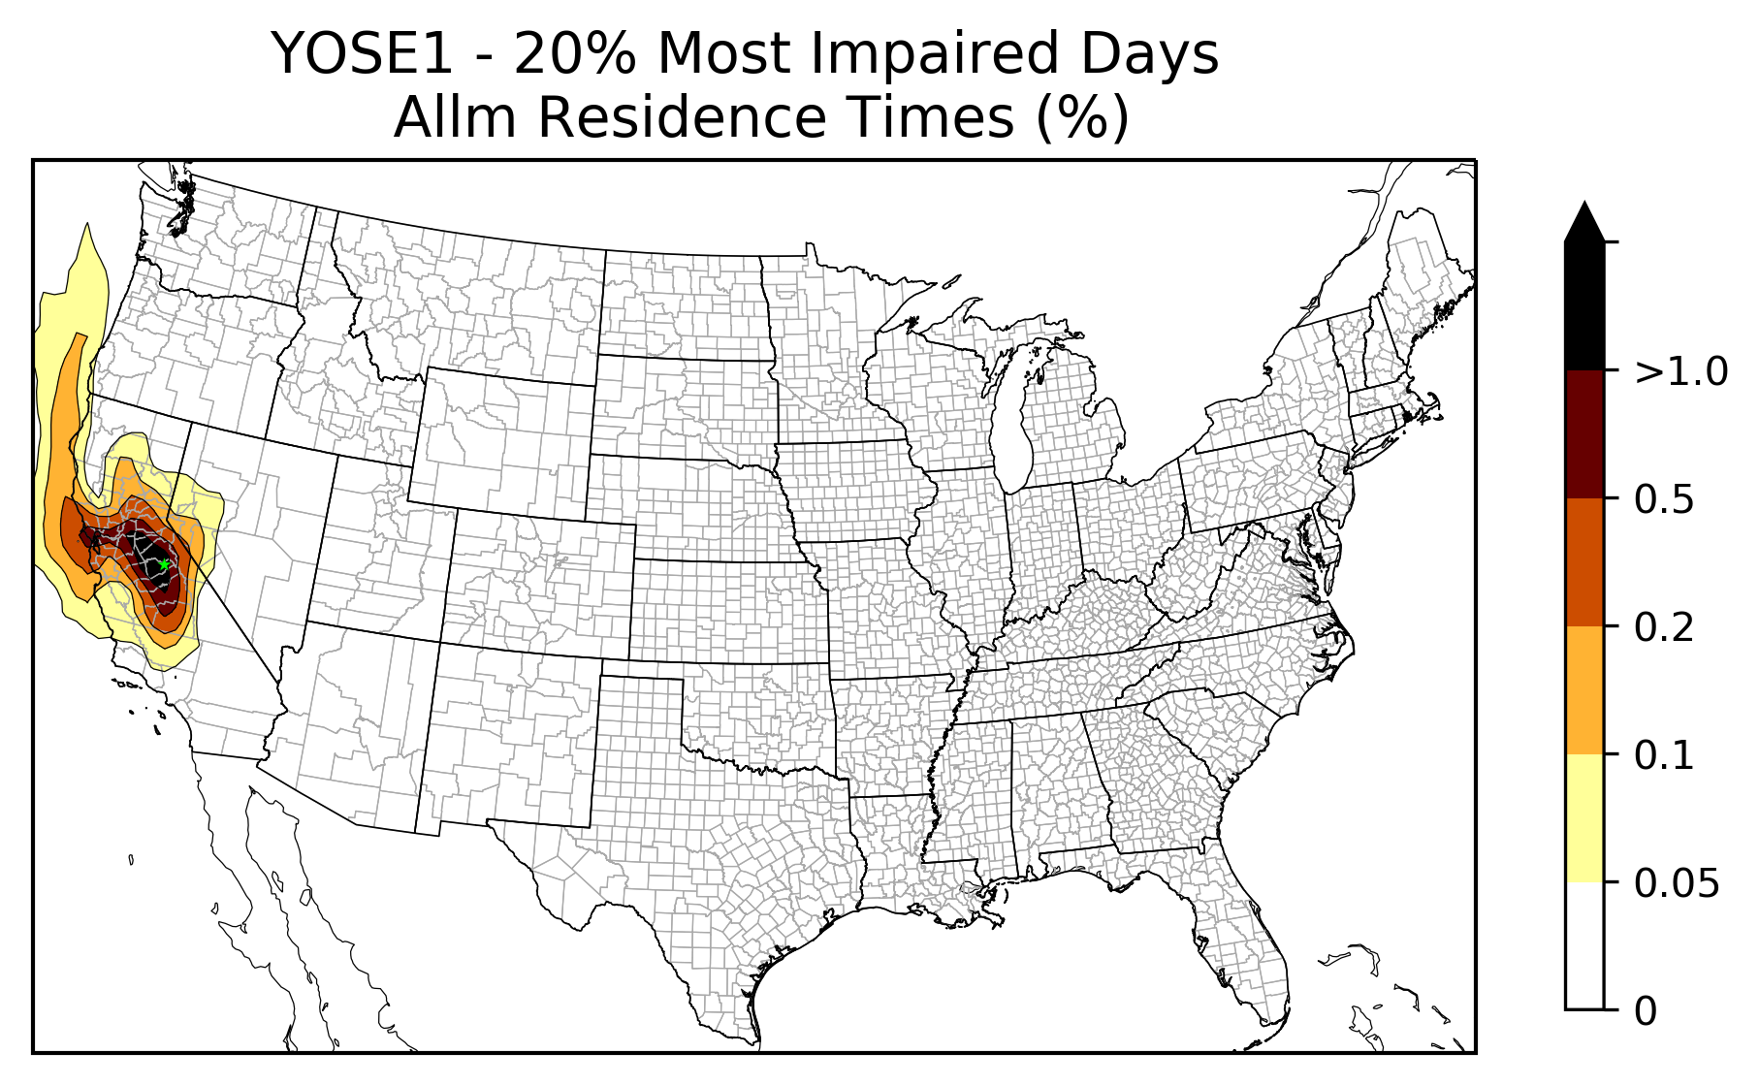
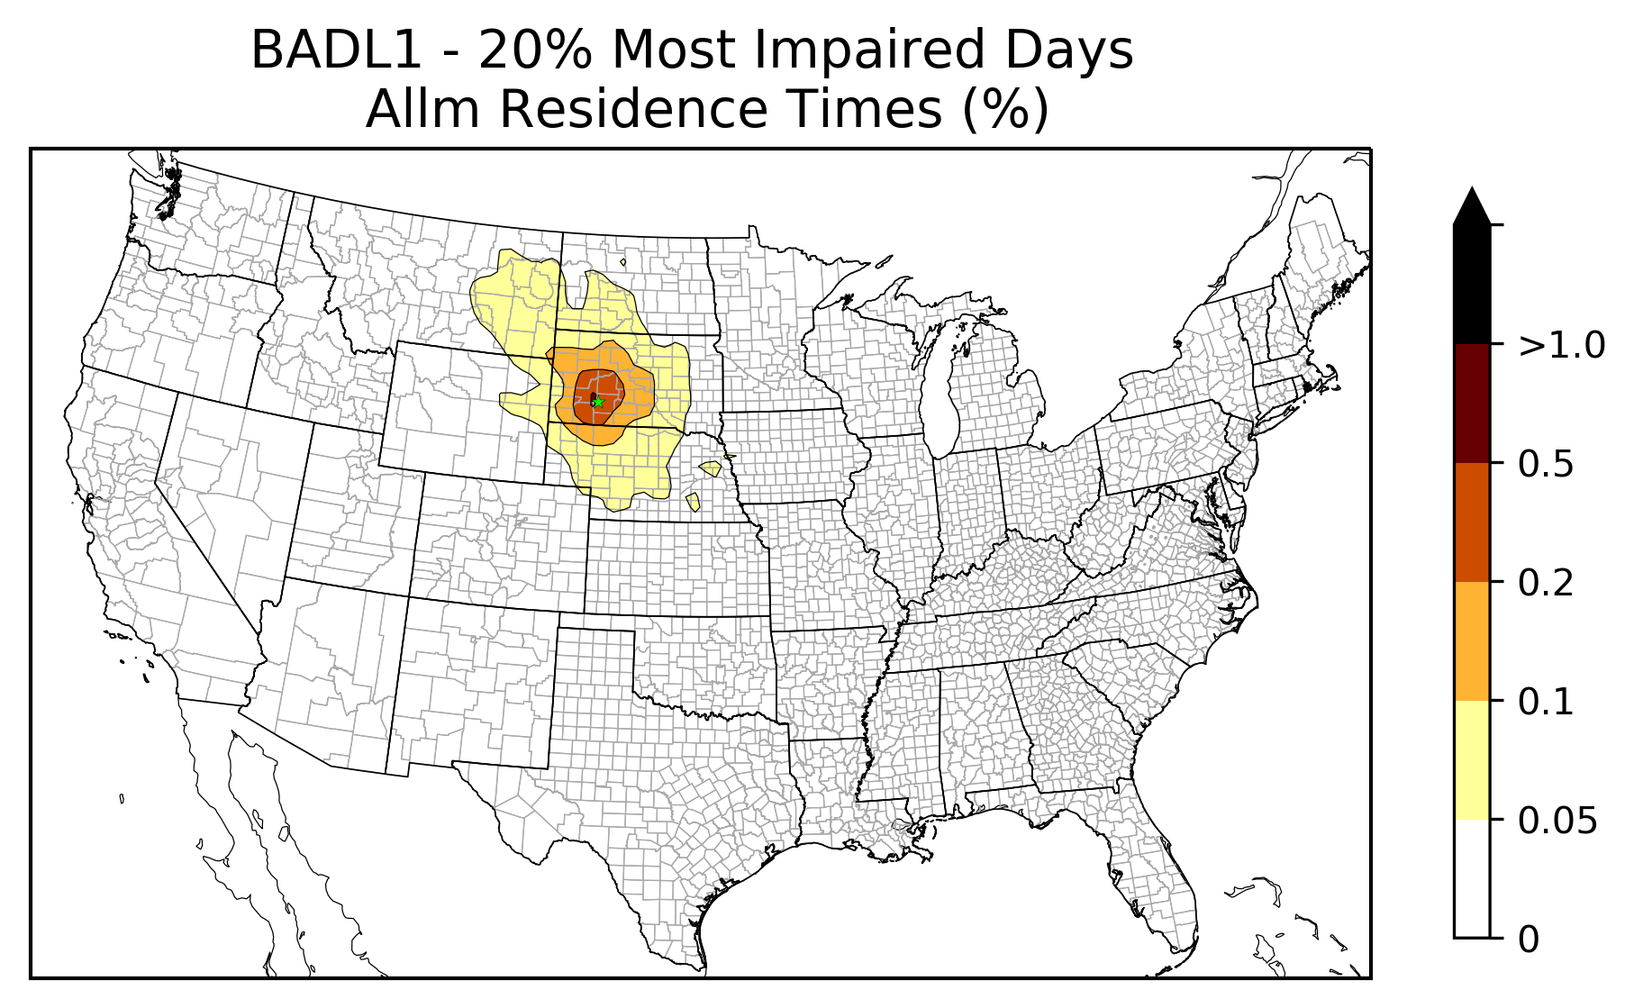
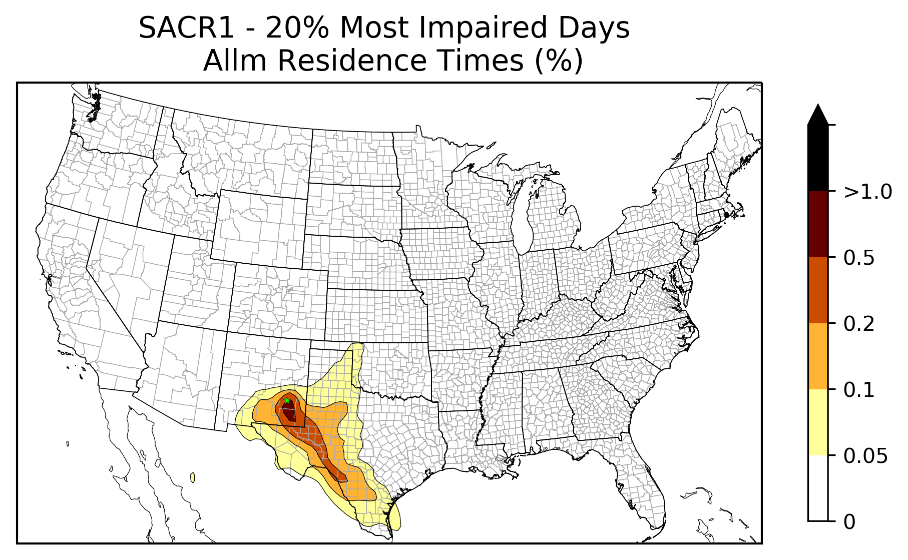
2028 Weighted Emissions Potential
Badlands
Hysplit Back Trajectory analyses from IMPROVE monitor:
2014-2018 Most Impaired Days (MID) - ~120 days
Residence Time Analysis
Calculated for each 36 km CAMx grid cell
WRAP_RTOWG_ModelingUpdate_2020-02-26v2.ppt
http://www.wrapair2.org/RTOWG.aspx
Notes:
Smoothing algorithm is ….
Python tool to read in the HYSPLIT timestep endpoints, count points in gridcells and make smooth maps

Slide 13
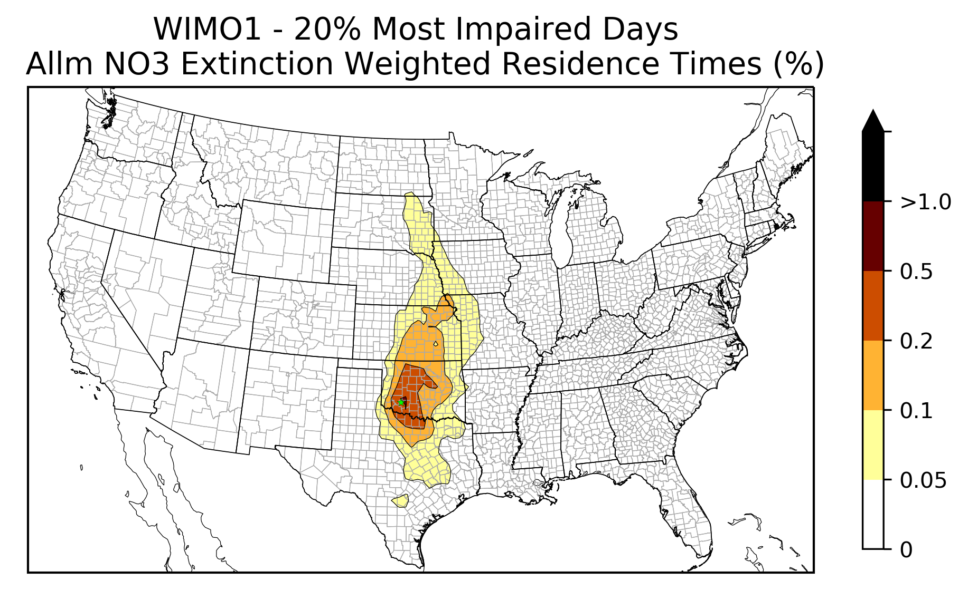
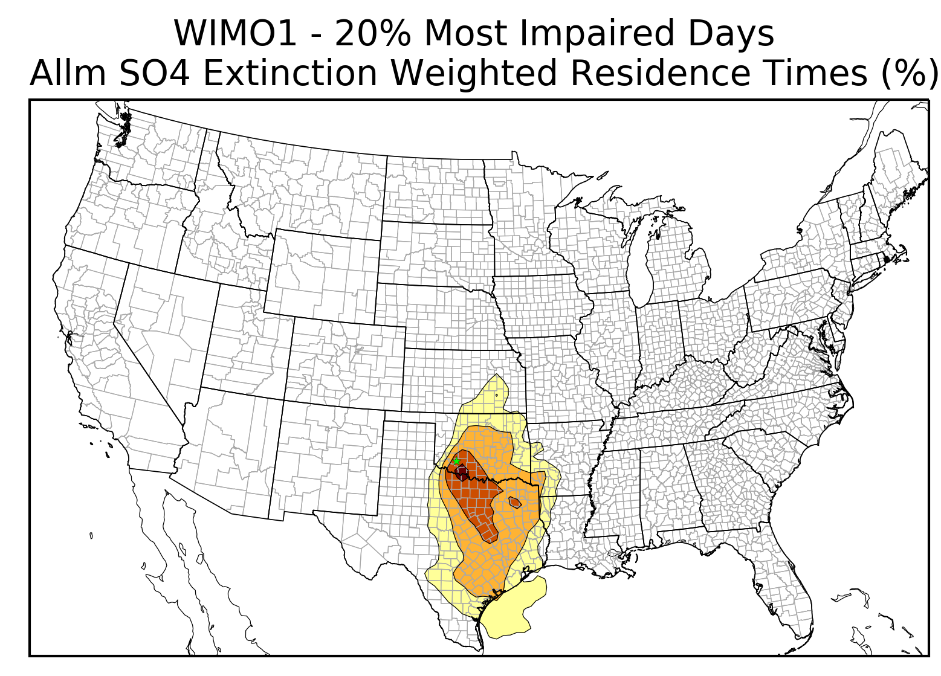
2028 Weighted Emissions Potential
Extinction Weighted Residence Time (EWRT)
Weight the Residence Time by the Sulfate, Nitrate, Elemental Carbon, Organic Carbon Extinctions (b_{ext}) for each MID
Trajectories with highest visibility impairment have the most influence on the AOI
May indicate different AOIs for different visibility impairing pollutants
NO₃ Extinction Weighted
SO₄ Extinction Weighted
Notes:
Most sites in WRAP we don’t see huge differences, but the more east we get we see larger differences. In this case reaching up for ammonia

Slide 14
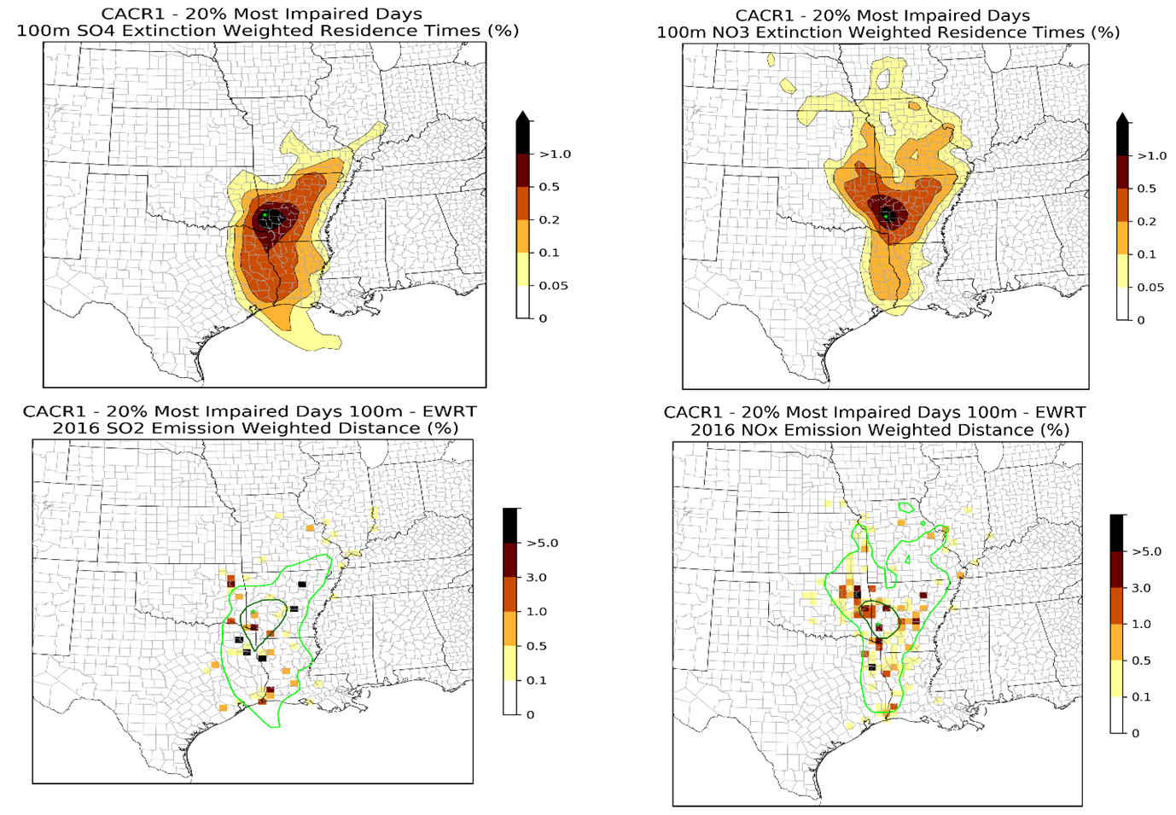
2028 Weighted Emissions Potential
Weighted Emissions Potential
2028OTB Emissions (SO₂, NOx, EC, OC) divided by distance, weighted by Extinction (SO₄, NO3, EC, OC) weighted Residence Time.
All anthro emissions in grid cell
By source sector (e.g. EGU, industrial point, onroad)
Rank EGU and Industrial Source facility level by SO2 and NOx weighted emissions potential for each Class I area
Example plots from CenSARA since 2028 WEP still in development

Slide 15
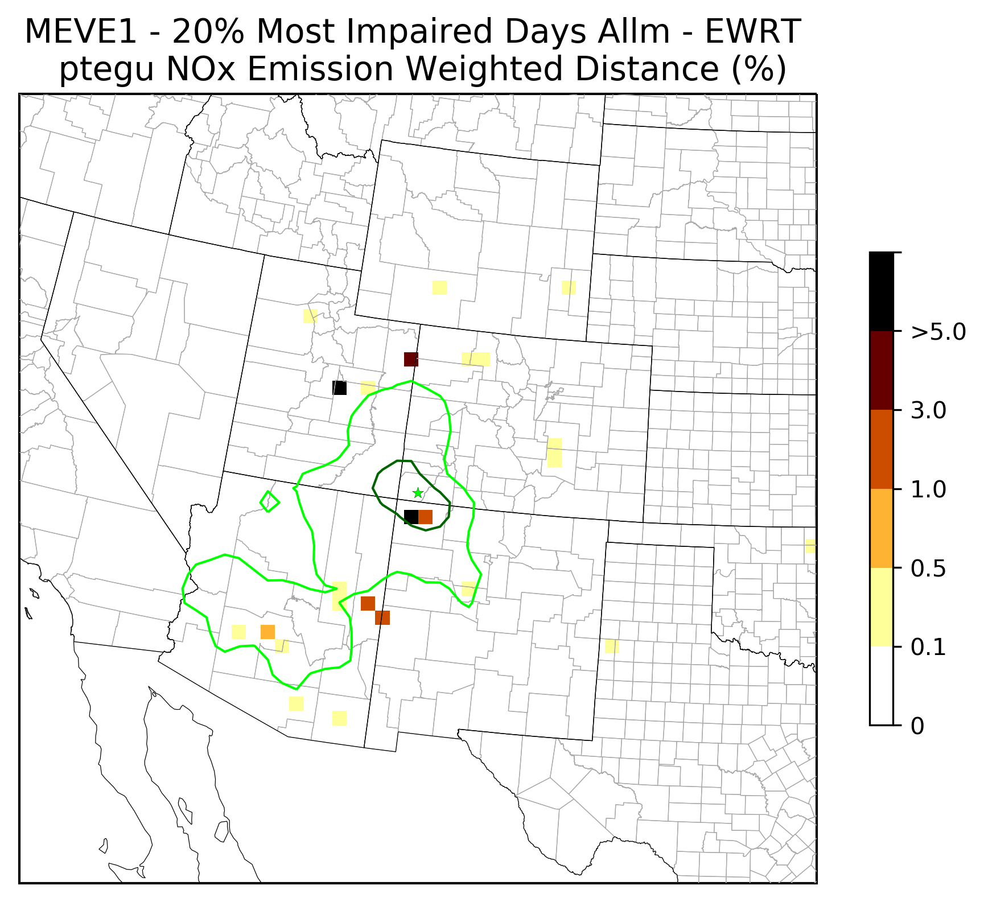
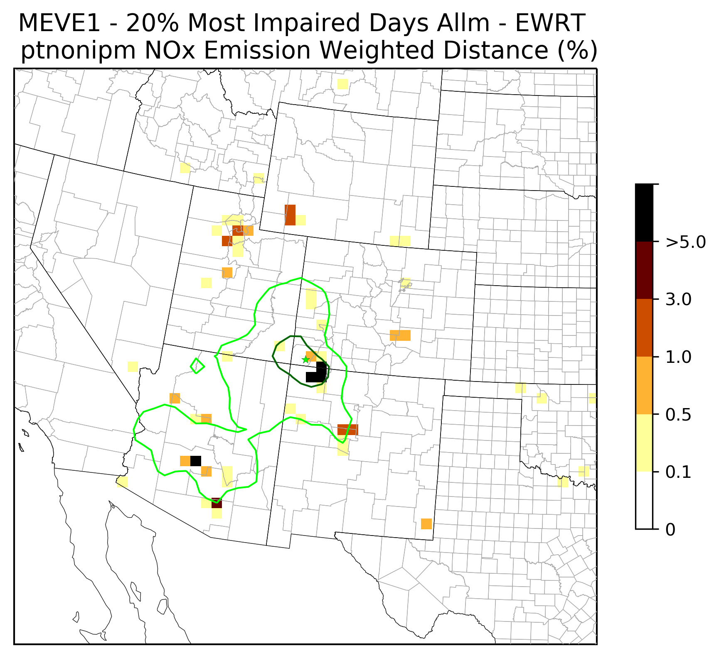
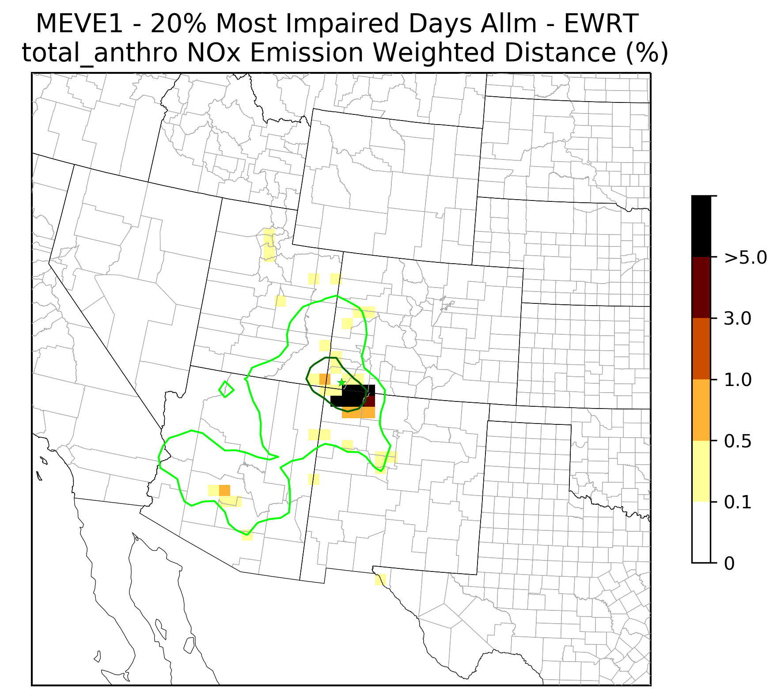
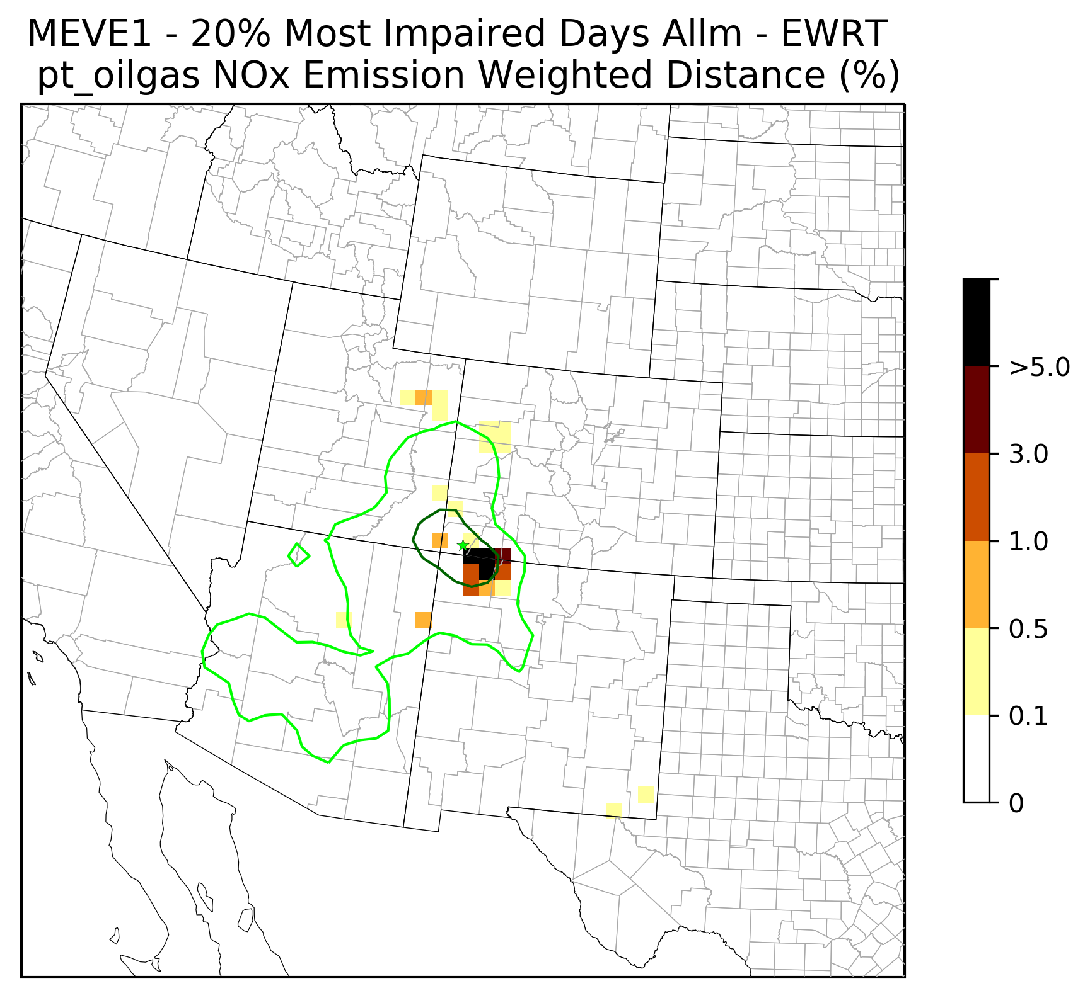
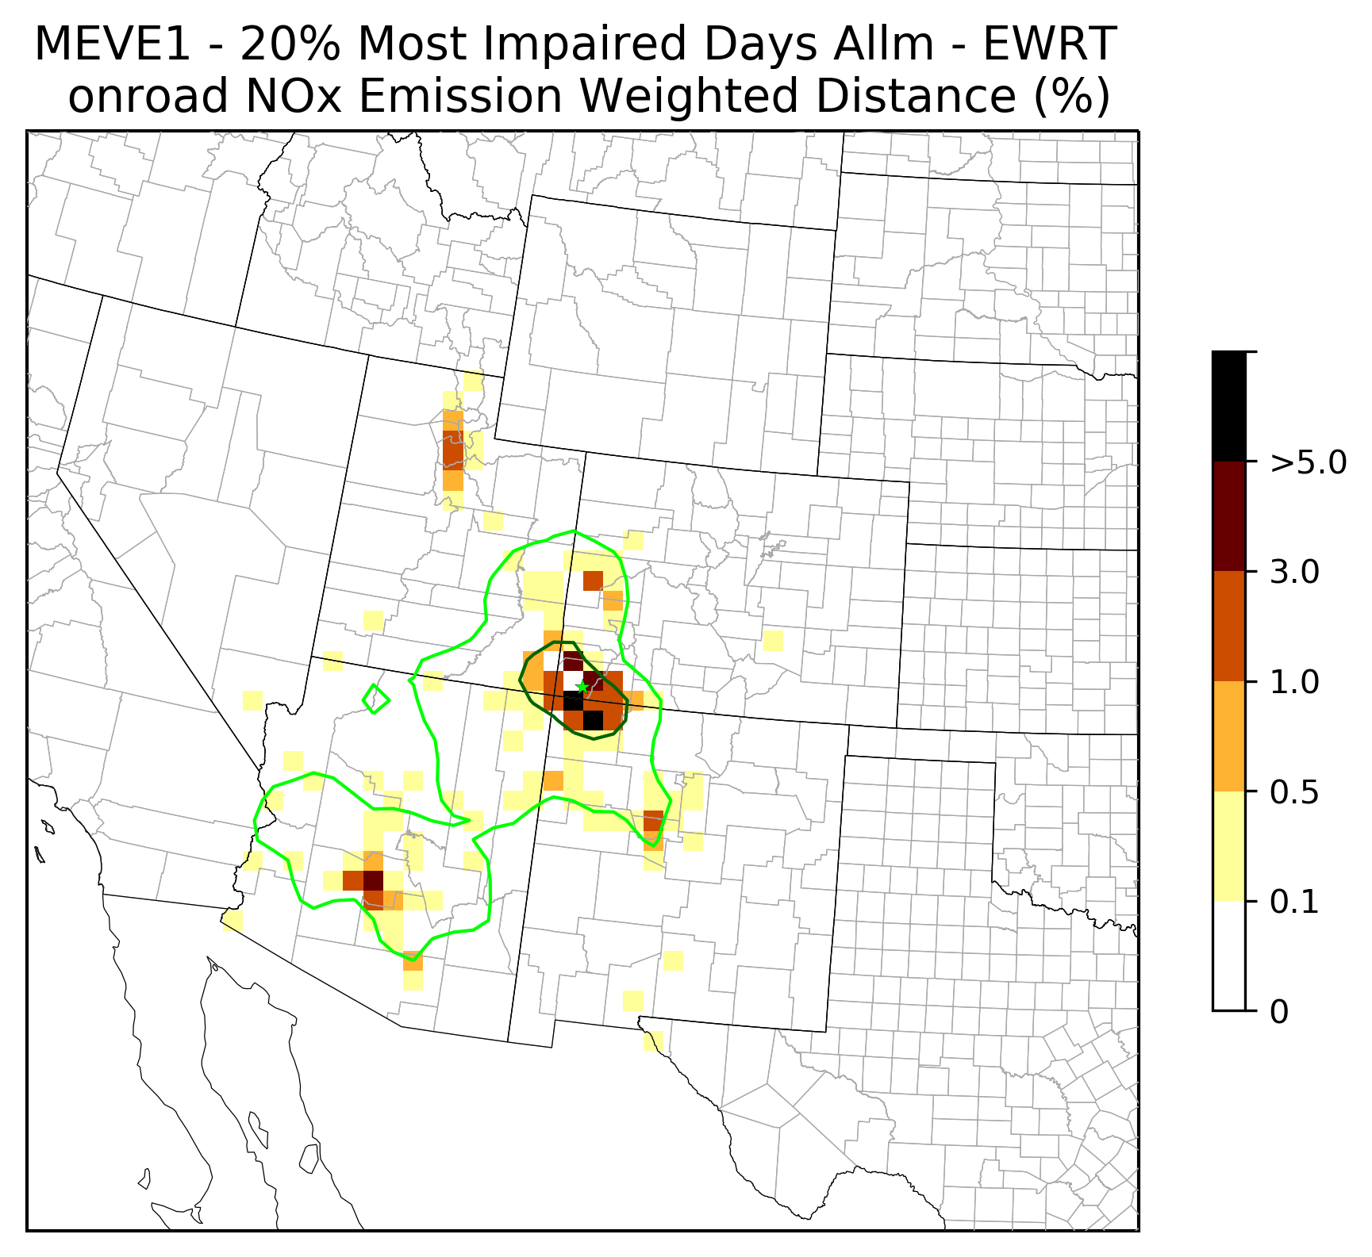
Example: Mesa Verde WEP NOx
EGU Point
Non-EGU Point
Total Anthropogenic
O&G Point
On-Road Mobile

Slide 16
Weighted Emissions Potential Compared to Q/d analysis and regional air quality modeling
Advantages:
Accounts for geography and transport paths to CIA on MIDs
Can use extinction weighting
Significantly less costly than PGM modeling
2028 WRAP emissions
Disadvantages:
Uncertainties in HYSPLIT back trajectories
Does not account for chemical transformation
Difficult to compare rankings across different CIAs
Not quantitative
No estimate of how visibility impairment would change based on emissions reductions
More costly than Q/d

Slide 17
Discussion: what data are states using to evaluate anthropogenic emissions for 4 factor analysis?
WRAP
2014 Q/d – delivered 2019
2028 OTB emissions for regional modeling – delivered Mar 2020
2028 Weighted Emissions Potential – initial delivery Mar 2020
2028 Source apportionment – modeling in progress Mar-Apr 2020
States

